Slide 1
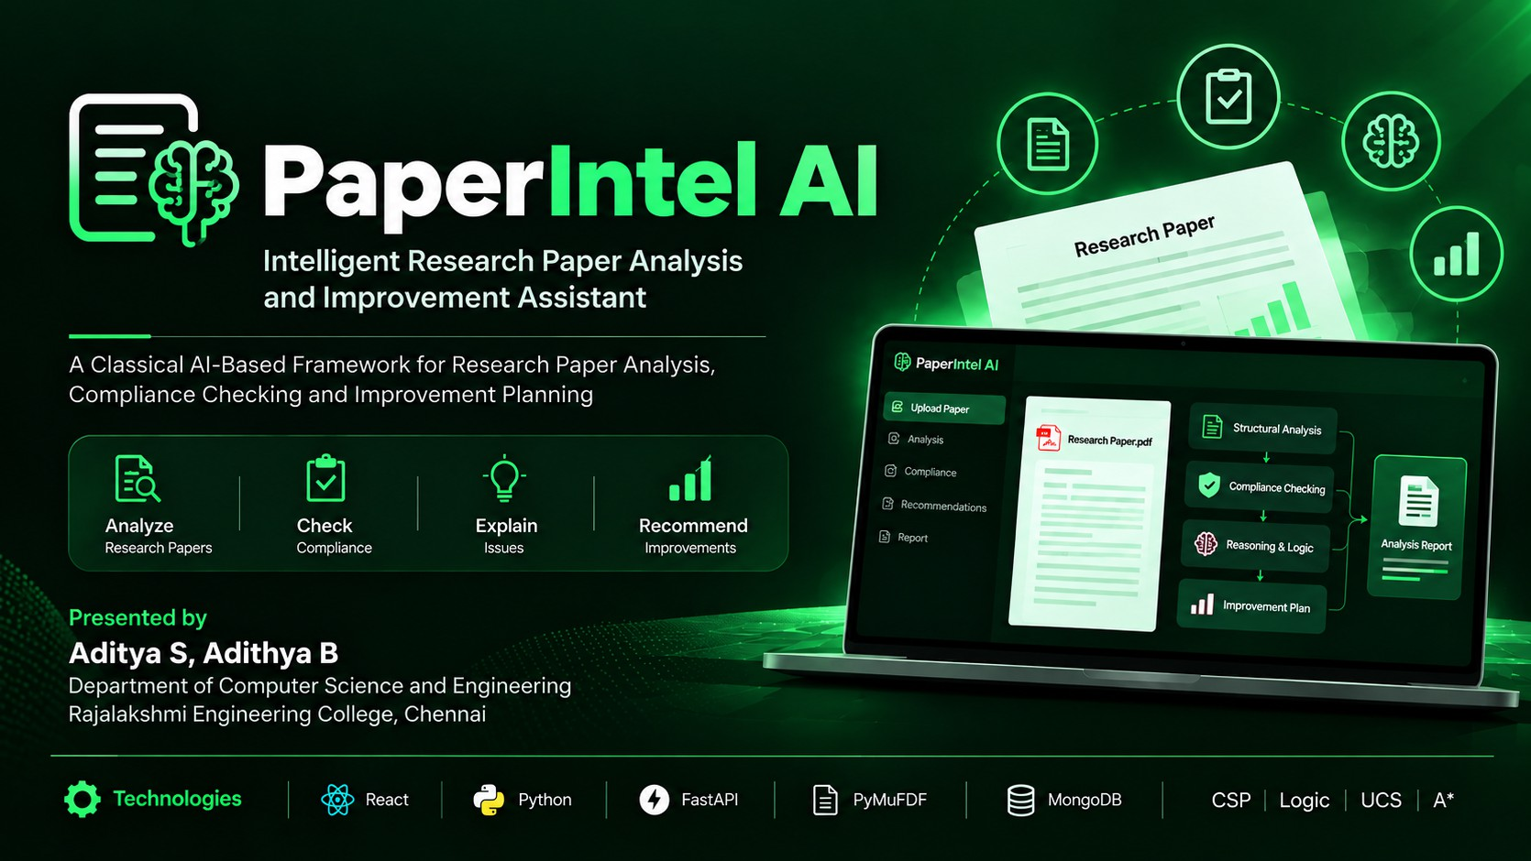

Slide 2












Pa
per ^{n t} e
e .! h a e! dli,and Improvement Assistant
02/
Abstract
Structural
_{A}nal§SIS
. ..
/
—— ——
Compliance Checking
Research papers require checking for structural completeness, logical consistency and guideline compliance before submission.
Manual checking is time-consuming, repetitive and difficult to trace systematically.
Reasoning
& Logic
Paperlntel Al automatically extracts the structure of a research ” paper from a PDF and converts it into a structured knowledge
representatio n.
The system applies rule-based propositional logic,
” CSP-based compliance checking and UCS/A” planning to identify issues and recommend improvement actions.
Improvement*' Planning
An Integrated Analysis Agent combines evidence, reasoning, compliance and planning results into an explainable report.
IEEE ACM
^{FCh} GUÏdeline_{s}
The system is designed as a deterministic classical-Al framework, without LLMs, ML models or external AI APIs.
- “

Slide 3













Paperlntel Al
03 / 07
intelligent Research Paper Analysis and Improvement Assistant
Literature Survey
Several studies have explored automated compliance checking, logical reasoning, and document analysis. However, most existing approaches focus on specific domains or individual techniques.
Letia & Groza {2OJ3) Compliance Checking of Integrated Business Processes
The Promise of Automated Compliance Checking (2021)
Chen & Jiang (2024) Ontology-Enhanced NLP for Automated Compliance Checking
Approach
Logical framework using normative temporal logic and description logic for compliance.
Review of rule-based and automated compliance checking approaches.
pproach
Ontology-based NLP with logical rule formalisation for compliance checking.
O ‘
B
Key Contribution
Formal representation of compliance rules and verification methods.
B
key Contr but on Identifies methods, challenges
andfuuedirecnov+or
automated compliance checking.
B
Key
Combines semantic extraction with formal reasoning to improve compliance checking
j | Limitation / | Focuses on business-process | j | Limitation / | Highlights difficulties in |  | Limitation / | Strong in semantic understanding,
” | Relevance | compliance, not research-paper | ” | Relevance | formalising requirements and | ” | Relevance | but domain-specific to
 |  | analysis. |  |  | processing normative rules |  |  | fire-safety compliance, not
 |  |  |  |  | across domains |  |  | research-paper anaIys's.
Key Takeaway
Existing work demonstrates the effectiveness of formal rules, knowledge representation and automated compliance checking. However, there is limited integration of document structure analysis, logical reasoning, compliance checking and improvement planning for research papers, which Paperlntel AI aims to address.

Slide 4
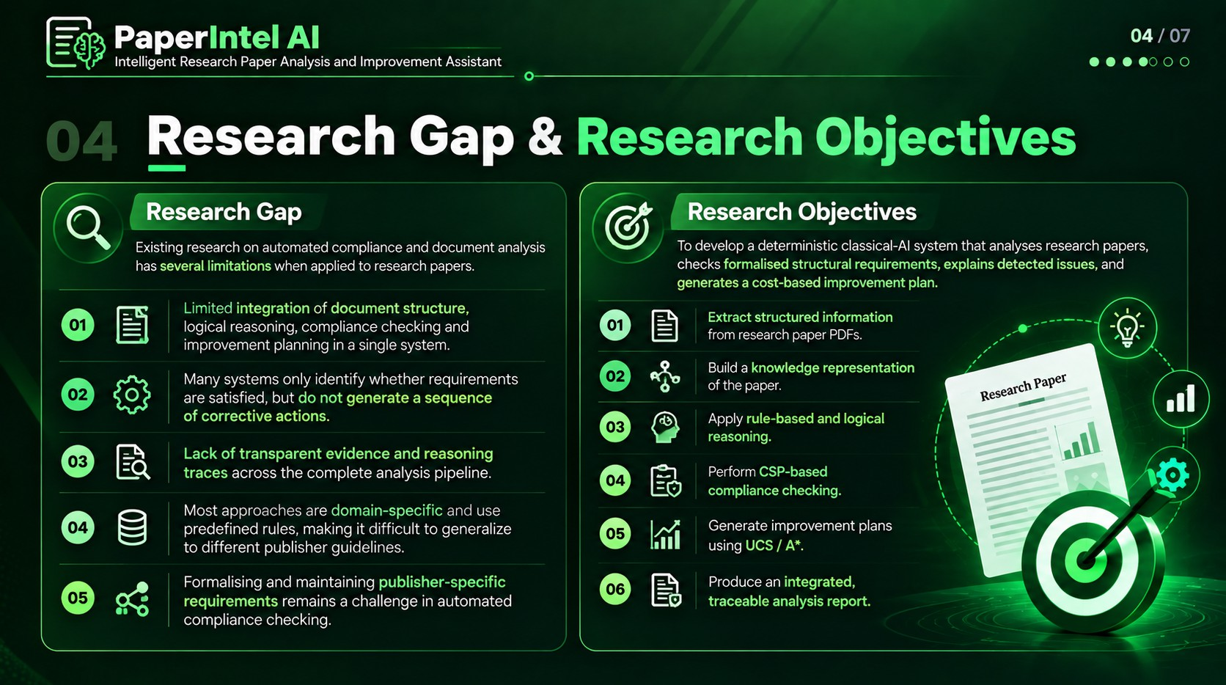

Slide 5
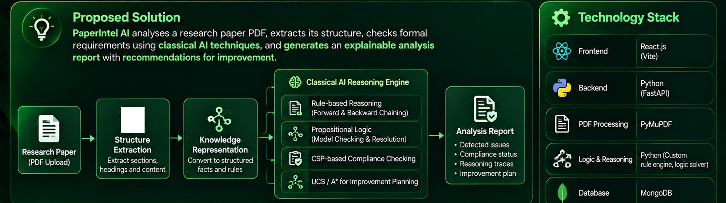








Paperlntel AI
05 / 07
intelligent Research Paper Analysis and Improvement Assistant
Proposed Solution & Technology Stack
Key
I I
Visualization
Chart.js
Automated Analysis
Extracts and analyses
Compliance Checking
Validate s against formal
guidelines using rules & C'2P
Explainable Results
Provides reasoning traces
and clear explanations
Improvement Planning
Suggests actionable
?
-

Slide 6

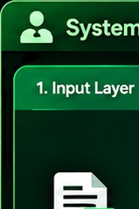



















Șystem Architecture & Algorithms
06 / 07
System Architecture
Algorithms Used
1. Input Layer
2. Processing Layer
3. knowledge Layer
4. Reasoning & Analysis Layer
5. Output Layer
!’‘
Rule-ba*ed Reasoning
using predefined rules to infer compliance and ide-nut issues
PDF Parsing (PyMuPPF)
Rule-based Reasoning
tForward 8 8ackward Chaining)
Proposifional logic
Model checking and resolution to validate logical consistent
Pepresmutation
Propositional Logic
(Model Checking & Resolution)
Structure
Explainable
Analysis Repon
Research Paper PDF Upload
—
{headings. Sections.
C$P-based Compliance Checking
Knowledge Base
Detec ted Issues
Compliance Status
Peasoning Traces
Improvement Plan
Pesommendations
CMP-based Compliance Checking
Constraint satisfaclion to vefify compliance wilh publisher guidelines.
Preprocessing (Text Cleaning & Normalization)
UCS / A' for Improvement
(Optimal Suggestions)
UCS / A for Improvement Planning
Search algorithms to generate optimal and ac tionable implement suggestions.
Data Flow
Reasoning 8 Compliance Cheeding
Improvement Planning (UCS / A”)
Explainable
§/ Peoon
8now ledge “

Slide 7
t e l f!r,••,t::!» a e
07 / 07
@s
^{I} . n improvement.ssistant
a d
"

Slide 8


